Slide 1
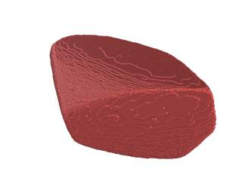
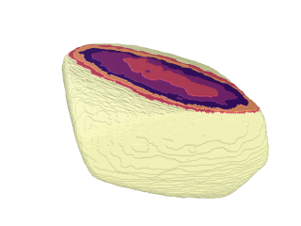
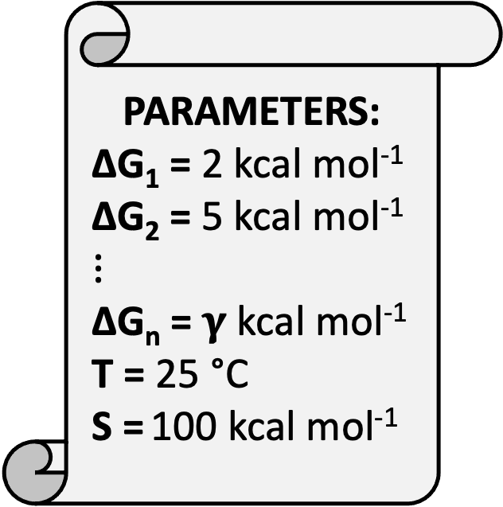

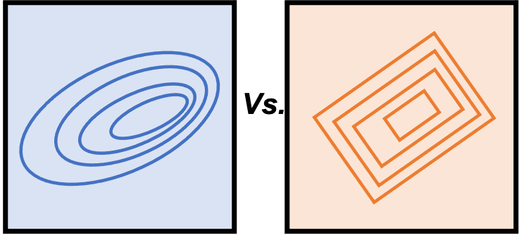
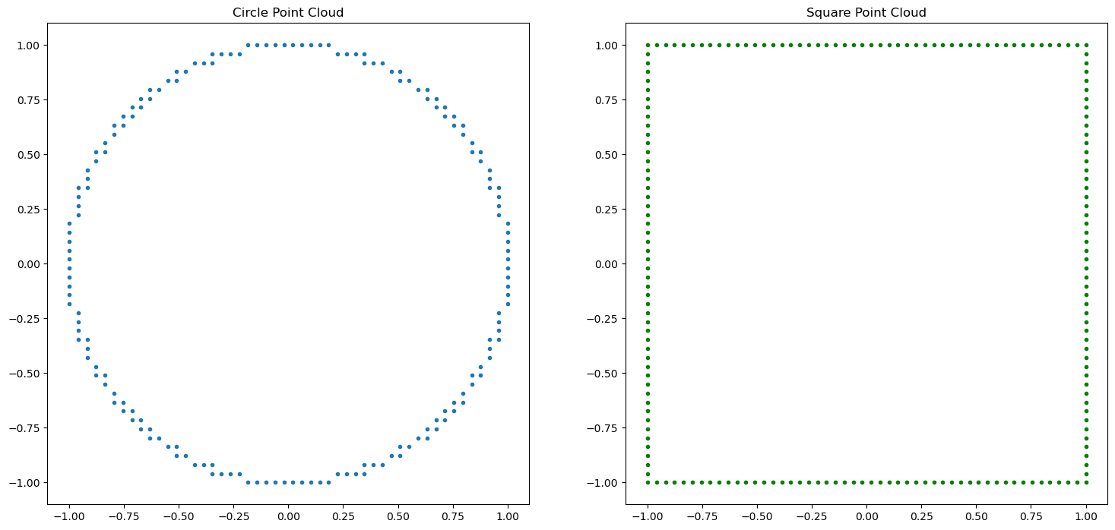
What is a simulated facet?
Steven Tendyra | BASF Crystallisation Cluster | 23.01.2024
Simulated facet = 3D point cloud with constant z for a given terrace – we can use various mathematical tools to describe (quantify) our terrace shapes
(100)
SIMULATION
simulation
Facet of interest
NumPy array
Facet point cloud
Definition and quantification of terrace shape
50x50
50x50

Slide 2
Shape metrics – defining shape/structure in a 2D point cloud
Steven Tendyra | BASF Crystallisation Cluster | 23.01.2024
Distance and closeness matrices
Eigenvalues and Eigenvectors
Angle between triplets of consecutive points
Kullback-Leibler divergence
Binary cross-entropy
Square and circle point cloud
Power function point clouds
Definition and quantification of terrace shape
50x50
50x50

Slide 3
Starting point: circle and square point clouds
Steven Tendyra | BASF Crystallisation Cluster | 23.01.2024
# Square point cloud: select only boundary points
square_mask = (np.isclose(points[:, 0], min_val) | np.isclose(points[:, 0], max_val) |
np.isclose(points[:, 1], min_val) | np.isclose(points[:, 1], max_val))
square_array = points[square_mask]
# Square and circle point clouds on a 50x50 grid
N_grid = 50
min_val, max_val = -1, 1
# Create a 50x50 grid
x_grid = np.linspace(min_val, max_val, N_grid)
y_grid = np.linspace(min_val, max_val, N_grid)
xx, yy = np.meshgrid(x_grid, y_grid)
points = np.column_stack((xx.ravel(), yy.ravel()))
# Circle point cloud: select points near the circumference
radius = 1
circle_mask = np.isclose(np.sqrt(points[:, 0]**2 + points[:, 1]**2), radius, atol=1/N_grid)
circle_array = points[circle_mask]

Slide 4
1 – Distance and closeness matrices
Steven Tendyra | BASF Crystallisation Cluster | 23.01.2024
2D array where each element (i,j) represents the distance between the i^{th} and j^{th} points in a dataset
Can apply to any quantifiable characteristic – for a square and circle, distance between points hints towards underlying structure of the shape
EUCLIDIAN DISTANCE
2D space
P₁ = (x₁, y₁)
P₂ = (x₂, y₂₎
Distance = sqrt((x₂-x₁)²+(y₂-y₁)²)
Closeness = exp(Distance²/2σ²)
Gaussian kernel or other inversion

Slide 5
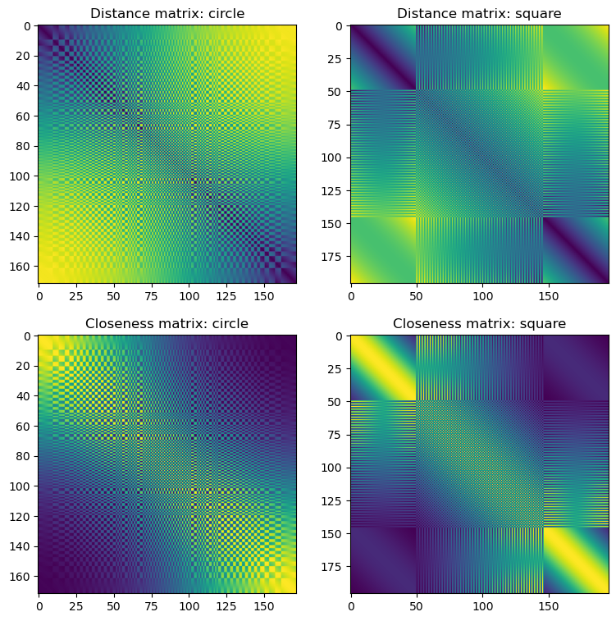
1 – Distance and closeness matrices
Steven Tendyra | BASF Crystallisation Cluster | 23.01.2024
Each cell is the distance between two points in point cloud
Pattern reflects underlying geometric regularity of the shape
GRADIENT – reflects circle’s radial symmetry
BANDS – regular spacing of points along the grid
BANDS – dark diagonal bands: high closeness between points on the same side of the square
BANDS – gradient colour change: uniform distribution of points in circle

Slide 6
1 – Distance and closeness matrices
Steven Tendyra | BASF Crystallisation Cluster | 23.01.2024
Can apply distance/closeness matrices in further analyses or to define other shape metrics
Hausdorff distance – max distance from a point in one set to the nearest point in another set
Shape context method – adds histogram of relative positions of neighbouring points – info about local geometry
Practical utility of distance/closeness matrices
Identifying shape features – symmetry and regularity
Shape signatures – can apply in ML classification/clustering
Comparison – crude; not as direct as Procrustes Analysis or Hausdorff

Slide 7
2 – Eigenvalues and eigenvectors
Steven Tendyra | BASF Crystallisation Cluster | 23.01.2024
Can calculate the eigenvalues and eigenvectors of our distance and closeness matrices
Examines the properties of the space defined by the pairwise distances or closeness of points within each shape
Can also indicate groups/clustering of points, which may correspond to features of the same
Identity matrix
det(A – λI) = 0
Av = λv
(A - λI)v = 0
matrix
EIGENVALUES
eigenvector
EIGENVECTORS
eigenvalue
“strength” or “magnitude”
DISTANCE MATRIX: Variance in pairwise distances; greater the value, greater the spread in how far apart points are from one another
CLOSENESS MATRIX: Variance in pairwise closeness
“direction”
DISTANCE MATRIX: Gives directions in which distances between points are most and least variable
CLOSENESS MATRIX: Gives directions along which the closeness between points varies the most
These principal directions can help identify symmetries or patterns in the arrangement of points within the shape.

Slide 8
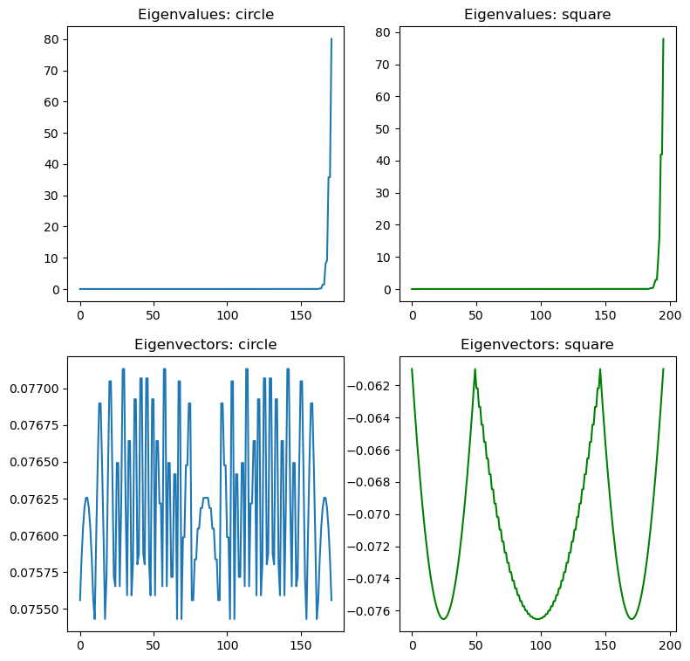
2 – Eigenvalues and eigenvectors
Steven Tendyra | BASF Crystallisation Cluster | 23.01.2024
Largest eigenvector – most significant features of shape.
Change towards the end – notable features of shape represented by smaller subset of dimensions of closeness matrix?
Complex pattern – varying degrees of closeness in data; low resolution (grid=50x50) of dataset?
Regular pattern – structured nature of square’s sides and corners, more predictable variation

Slide 9
2 – Eigenvalues and eigenvectors
Steven Tendyra | BASF Crystallisation Cluster | 23.01.2024
Interpretation relative to shape:
Dominant features – largest eigenvalue
Uniformity/symmetry – a perfect circle has a more uniform distribution of eigenvalues, reflecting its symmetry
Corners/edges – provides variation in closeness of points, thus creates a distinct pattern
Complexity of shape – can capture complex point distributions thus capture underlying structure
Can extend use of eigenvalues and eigenvectors for shape comparison:
PCA for alignment – shapes aligned along principal components are better suited to comparison
Shape descriptors – ratio of eigenvalues e.g. if one eigenvalue >> another it could indicate elongation
Dimensionality reduction – PCA can be used to reduce dimensionality whilst preserving structural features to give a benchmark

Slide 10
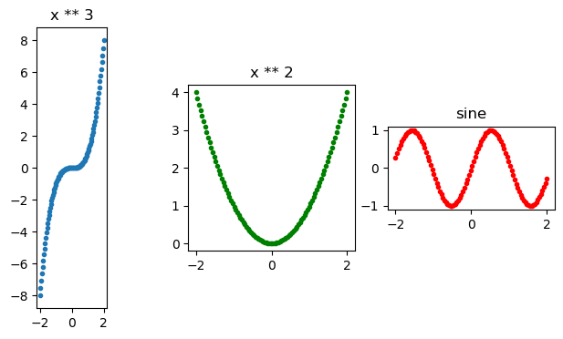
Starting point: power functions
Steven Tendyra | BASF Crystallisation Cluster | 23.01.2024
# 100 points in the region -2 to +2
x_grid = np.linspace(-2,2,100)
fn1 = lambda x : x ** 3
fn1_grid = fn1(x_grid)
fn2 = lambda x : x ** 2
fn2_grid = fn2(x_grid)
fn3 = lambda x, freq : np.sin(freq * x)
fn3_grid = fn3(x_grid, 3)

Slide 11
3 – Angle between triplets of consecutive points
Steven Tendyra | BASF Crystallisation Cluster | 23.01.2024
xxx

Slide 12
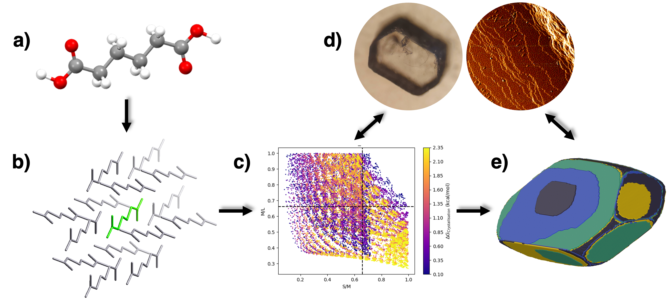
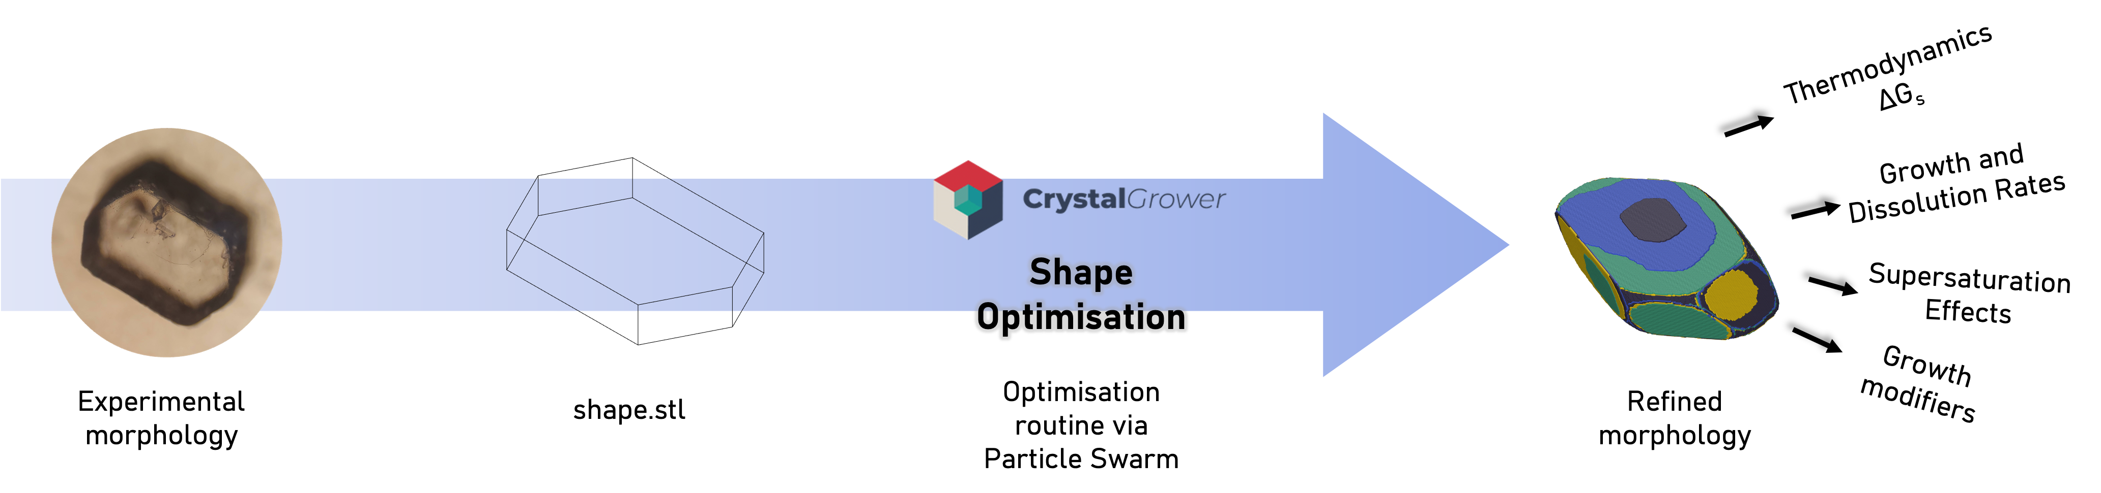
ADDITIONAL: Crystal Surface Optimisation: Data Burden/Bottleneck
Steven Tendyra | BASF Crystallisation Cluster | 23.01.2024
Bottleneck in CrystalGrower workflow lies in correlating simulation parameters with experimental data
Large data burden associated when exploring the parameter space for a new system – 100,000+ simulations typically required!
Existing optimisation routine allows for convergence on solution from a reference .stl shape for an overall morphology – no existing quantification of surface topography or ‘shape’
Modelling workflow:
a) .cif file
b) Connected ‘net’
c) Bulk simulations across thermodynamic parameter space
d) Refinement against experimental data: aspect ratio (morphology) and visual (surface)
e) Refined structure
Bottleneck occurs when validating simulations
against experimental data
Existing routine
for overall
morphology

Slide 13
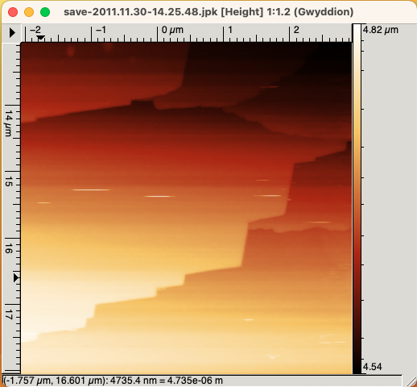
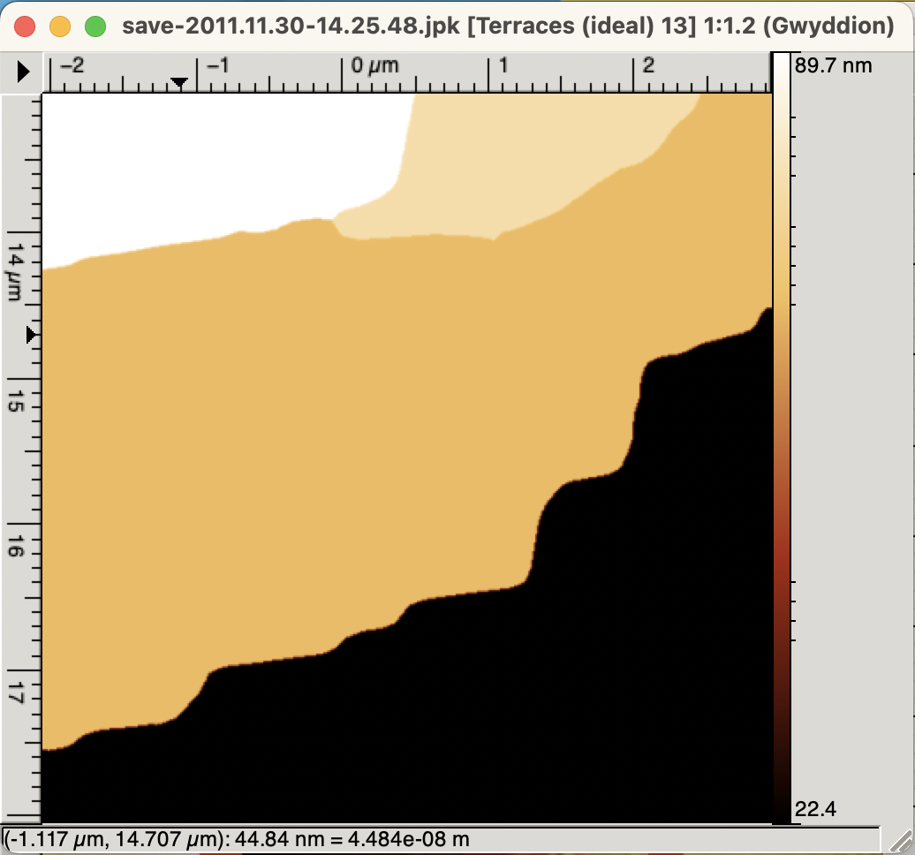
ADDITIONAL: Overview – Crystal Surface Optimisation
Steven Tendyra | BASF Crystallisation Cluster | 23.01.2024
- BASF data science expertise needed in identifying suitable methodologies for the development of an experimental microscopy <> simulation parameter refinement and optimisation routine - Particle Swarm Optimisation routine being developed by another group for overall shape/morphology refinement via spherical harmonics - Both methodologies would allow the CrystalGrower simulation workflow to avoid a costly multidimensional grid search across a given parameter space
FEATURISATION &
OPTIMISATION ROUTINE
Data levelling
Background subtraction
Terrace measurement Gaussian step filter, segmentation and fitting
Bayesian? Particle swarm? Gaussian?
EXPERIMENT
AFM data collection
Processed AFM Data
Image data
as NumPy array
Shape description
Quantification of ‘distance’
(100)
TDA?
Fourier transform?
Spherical harmonics?
Shape comparison
BEST PARAMETERS
Refined surface topography
SIMULATION
Increment
parameters:
ΔG_{s} crystallization free energies
Temperature
Supersaturation
simulation
Facet of interest
NumPy array
Facet point cloud
Shape description

